Slide 1

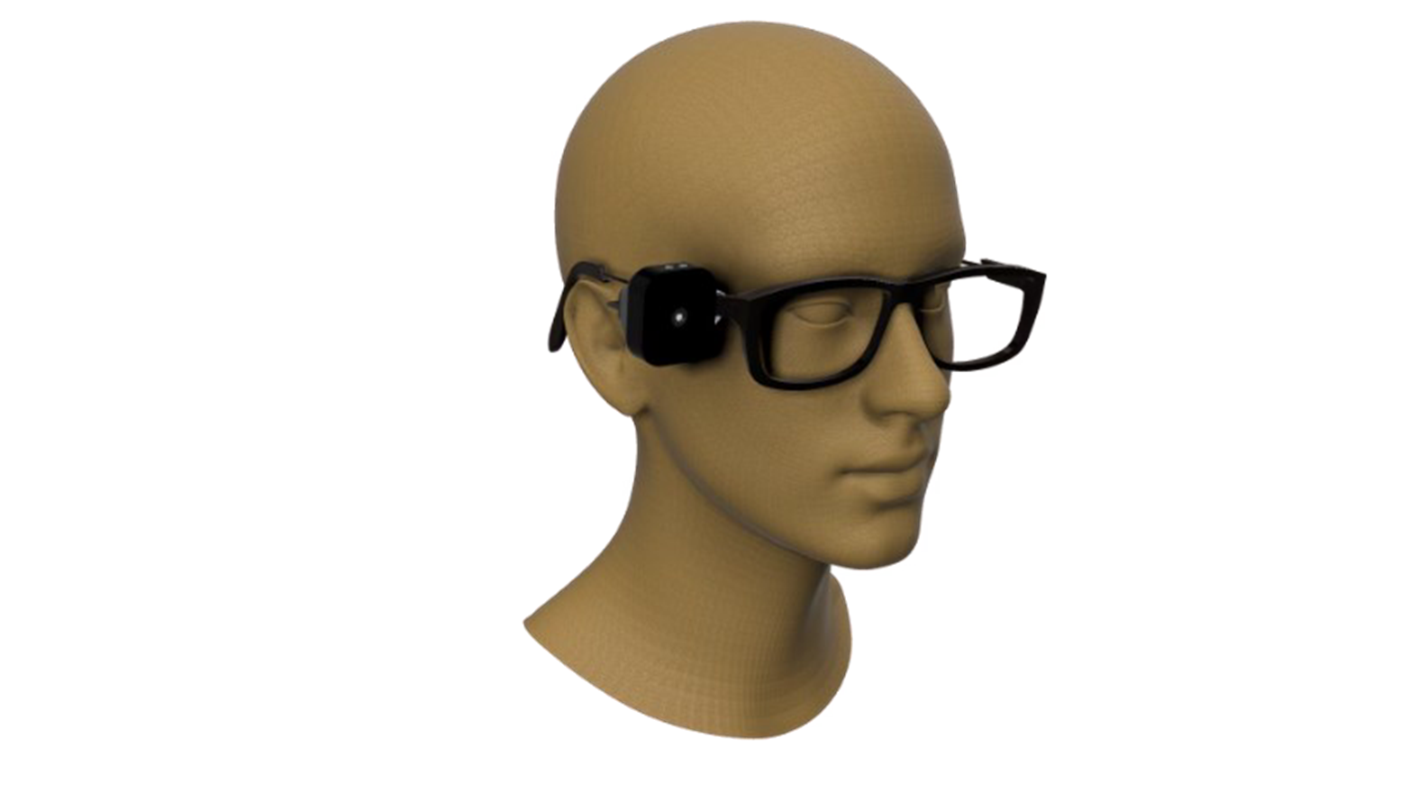
An Advanced system that assists visually impaired individuals

Slide 2
1
Project Supervisors
Prof.
Dr. Amany Magdy Mohamed
Teaching Assistant
Eng. Dina Mohamed

Slide 3
2
Team Members
 | Student Name | Student ID
 | Taha Mohamed Khalaf | 21-01656
 | Mahmoud Adel Sadek | 21-00940
 | Sama Moustafa Ibrahim | 21-01553
 | Nada Ahmed Hamoda | 21-01337
 | Nooran Abdulbasit Ali | 21-01361
 | Renad Mohamed Fawzy | 21-01502
Nada Ahmed Hamoda
Taha
Mohamed
Khalaf

Slide 4
3
Introduction
•Around 253 million people worldwide live with visual impairment, including 36 million who are completely
blind, according to the World Health Organization (WHO). Many of these individuals struggle with
performing daily tasks independently and often rely on caregivers for navigation and support.
•Technology offers a powerful solution to bridge this gap. This project introduces smart glasses specifically
designed to empower blind and visually impaired individuals. By integrating intelligent features, the
system delivers real-time interaction with the environment, aiming to enhance independence, safety, and
confidence in daily life.

Slide 5
4
Problem Definition
•Blind and visually impaired people still struggle to understand and interact with their surroundings.
Although there are existing technologies, most of them don't fully meet their real needs in daily life.
•With the rise of deep learning, computer vision, and natural language processing, there is a growing
opportunity to create assistive technologies that convert visual information into meaningful descriptions.

Slide 6
5
Related Work
Obstacle Detection Glasses
Objective: Detect obstacles using ultrasonic sensors for mobility support.
×Limitation: Limited to navigation only.
Text-Reading Glasses (Developed by Prince Mohammad bin Fahd University)
Objective: Read and translate English text using OCR.
×Limitation: Supports only OCR; lacks broader assistive features.
Amal Glass
Objective: Provide object detection, text recognition, and navigation assistance.
×Limitation: Lacks scene understanding, face recognition, and emotion detection.

Slide 7
6
Objective
•To develop a real-time smart glasses system that empowers blind and visually impaired individuals by
enhancing their ability to perceive and interact with their environment.
•The system aims to support daily independence through features like currency recognition, face and
emotion detection, object identification, and real-time text reading all in an accessible and affordable form.

Slide 8
7
Features and Functions
CDI Flow That
Contains Two Task
•Currency Detection
•Currency Identification
FDRE Flow That
Contains Three Task
•Haarcascad Detection
•Face Recognition
•Facial Expression
SD Flow That
Contains Three Task
•Image Capture
•Text Generation
•Final Image Caption
TR Flow That
Contains Two Task
•Text Detection
•Text Recognition

Slide 9
8
CDI – Currency Detection and Identification
Task Description: This flow is responsible for detecting and classifying Egyptian currency notes.
It consists of two main tasks:
Currency Detection
Model: Custom-trained YOLOv8
Input: Real-time frame from camera
Output: Detected bounding boxes around
currency notes
Currency Classification
Model: CNN based on fine-tuned MobileNetV2
Input: Cropped image of the detected note
Output: Predicted class of the currency (e.g., 0 = 5
EGP, 1 = 10 EGP, ..., 7 = 200 EGP)

Slide 10
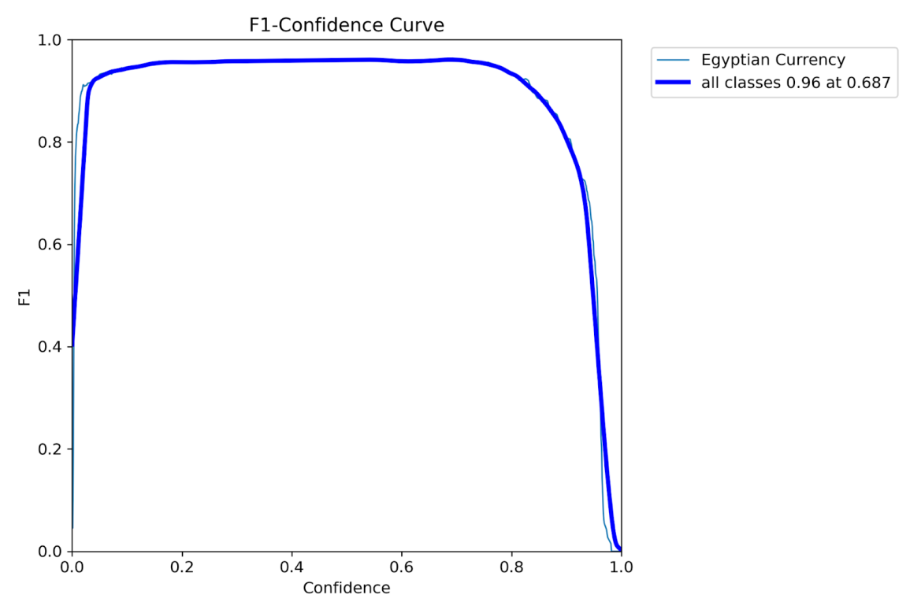
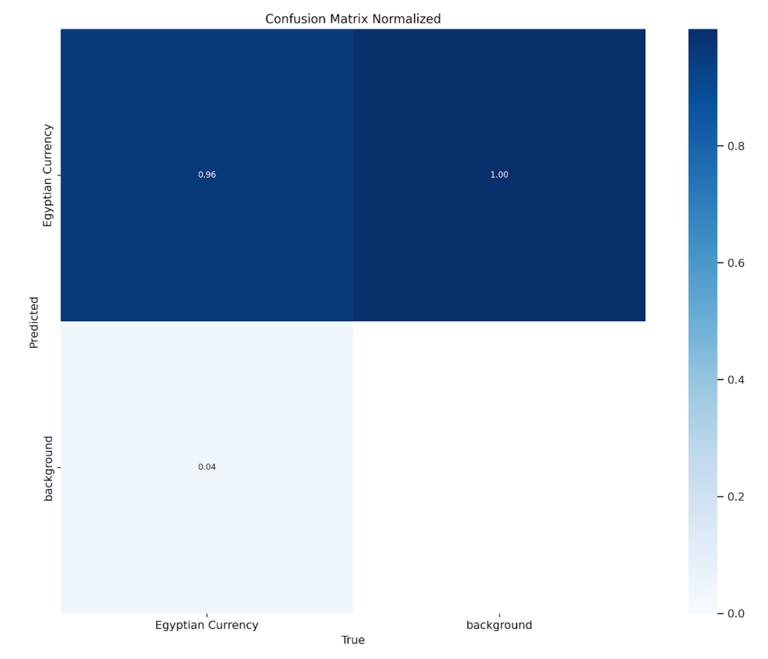
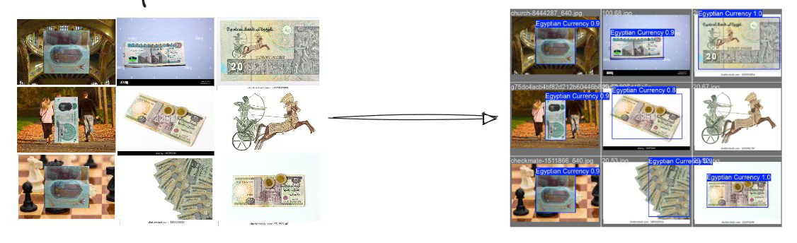
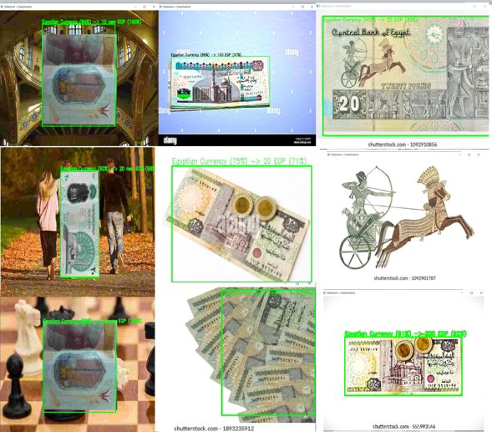
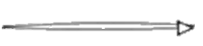
9
Evaluation
metrics

Slide 11
10
FDRE – Face Detection, Recognition, and Expression
Task Description: This flow is responsible for detecting faces, recognizing known individuals, and identifying
facial expressions. It consists of three main stages:
Face Detection
Model: HaarCascade
Input: Real-time frame from camera
Output: Detected face regions
Face Recognition
Model: CNN trained on a custom dataset
Classes: Cristiano Ronaldo, Mohamed Salah, Magdy
Yacoub, Leonardo DiCaprio, Nada, Nooran
Input: Cropped face from the detection stage
Output: Recognized person name
Facial Expression Classification
Model: CNN trained on FER-2013 dataset
Classes: Angry, Disgust, Fear, Happy, Sad, Neutral,
Surprise
Input: Same cropped face
Output: Detected facial emotion

Slide 12
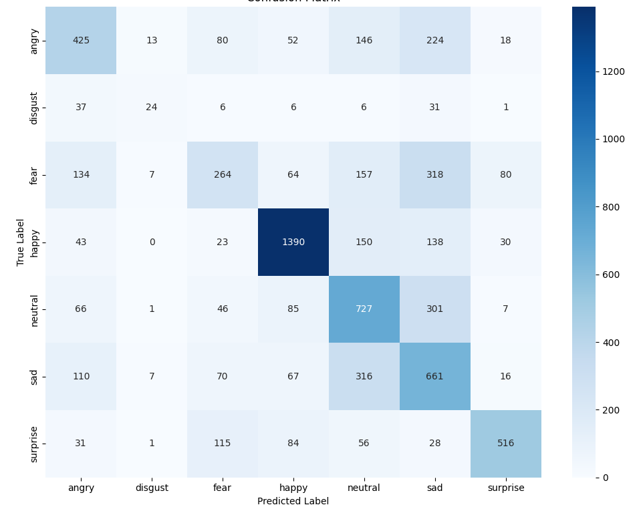
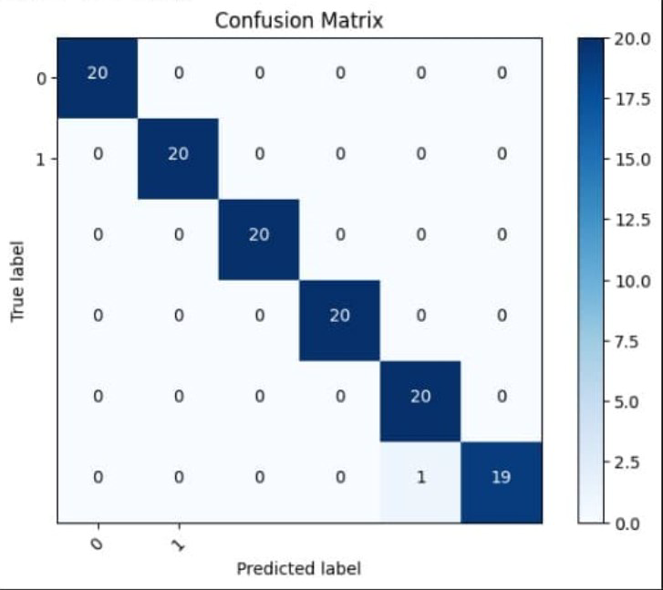
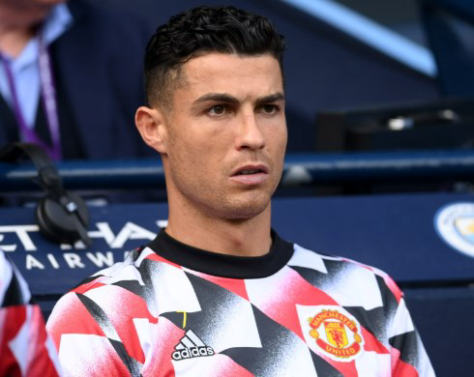
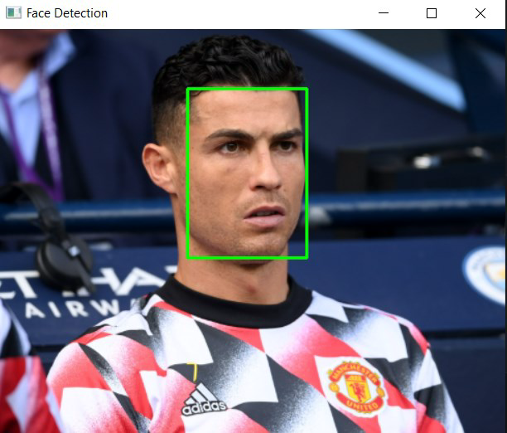
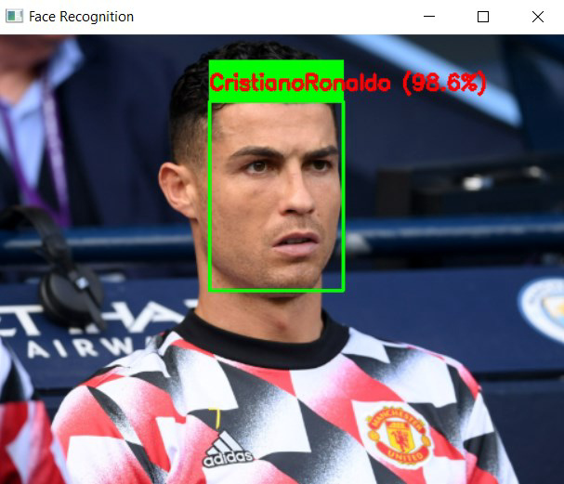

11
Evaluation
metrics

Slide 13
12
SD – Scene Description
Task Description: This flow describes the scene visually in natural language and converts it into speech for visually
impaired users. Due to the large model size, it is deployed as an API instead of running directly on the Raspberry Pi.
It includes three main tasks:
Text Generation
Model: BLIP Transformer (V1)
Description: Generates a natural
language description of the image
and its objects
Deployed as an API for better
performance
Image Caption to Speech
Converts the generated caption
into voice
Output: Audio feedback to the
blind user
Image Capture
Method: Real-time image capture
from camera
Output: Image frame for analysis

Slide 14
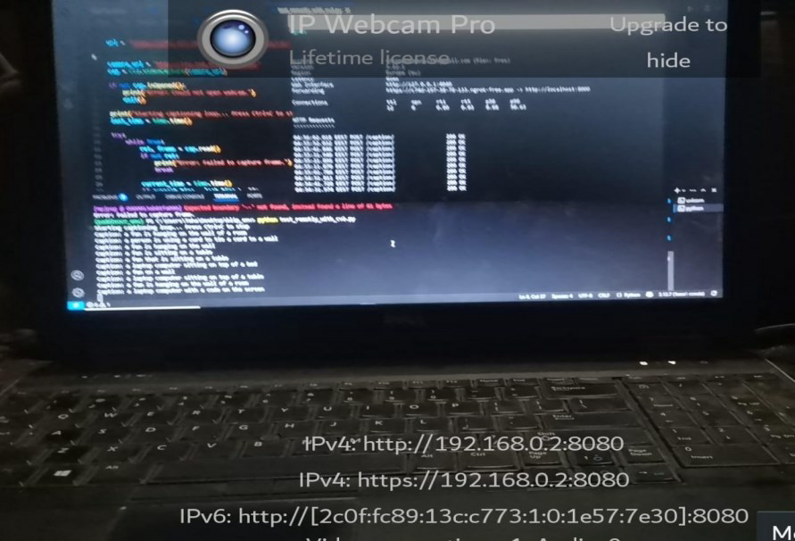
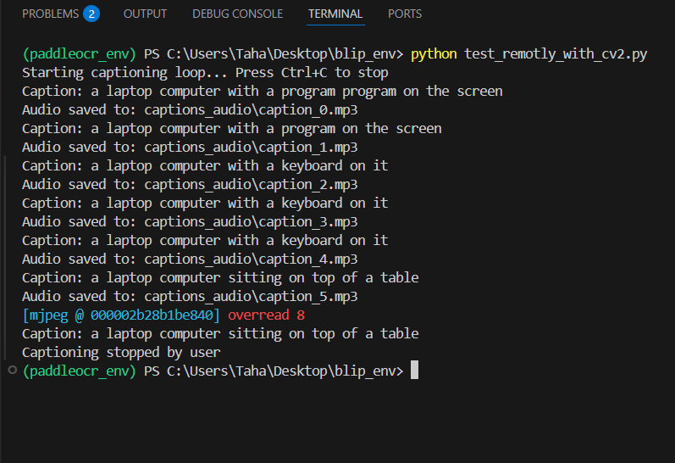
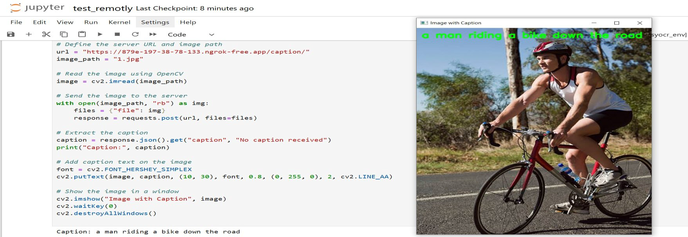


13
Evaluation
metrics

Slide 15
14
TR – Text Reading
Task Description: This flow detects and reads printed or written text from the environment using an OCR-based pipeline. It
uses Paddle-OCR, which is deployed as an external API to reduce the computational load on the Raspberry Pi.
The flow includes two main tasks:
Text Detection
Model: PaddleOCR
Input: Captured camera image
Output: Bounding boxes around visible text areas
Detects text areas then Sends cropped regions to the next stage
Text Recognition
Recognizes the characters and language inside
each detected box.
Supports multi-language recognition.
Outputs the detected text to the terminal and converts
it to audio.

Slide 16
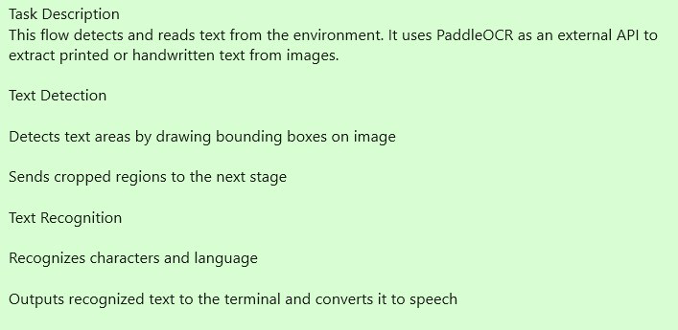
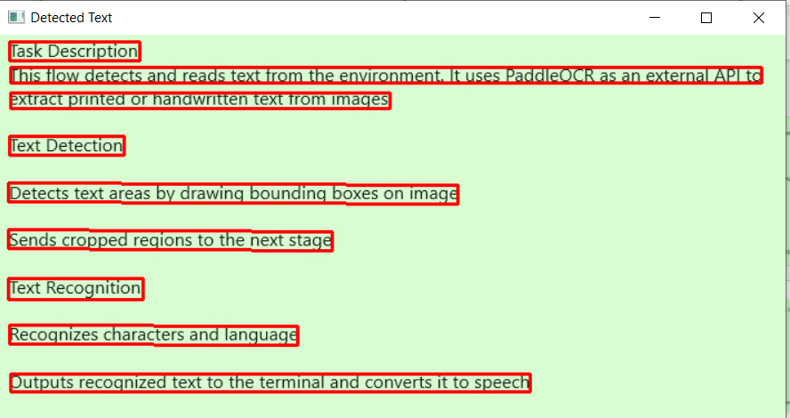
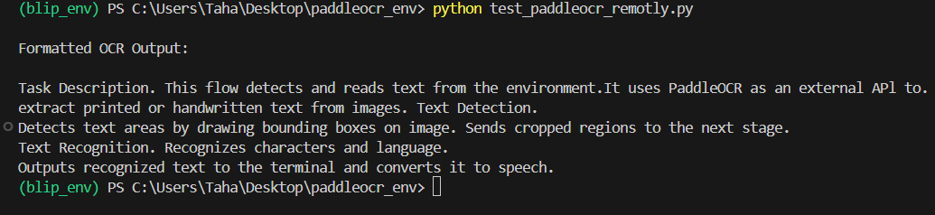
15
Evaluation
metrics

Slide 17
16
Datasets
The project utilizes multiple datasets tailored to smart glasses functions. For currency detection, a custom Egyptian banknote dataset with 3,690 labeled RGB images supports classification into eight denominations using YOLO, SSD, and CNN models. Face recognition uses a dataset of 2,400 images across six individuals, with varied lighting and expressions to enhance accuracy in real-world conditions. Emotion detection employs the FER-2013 dataset, containing 32,298 grayscale facial images across seven emotional categories, aiding in understanding social cues. Object detection relies on unnamed or standard datasets to train models like YOLO, enabling real-time environmental awareness and safer navigation.

Slide 18
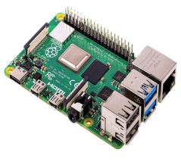
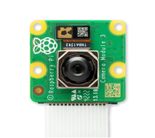
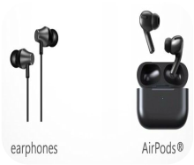
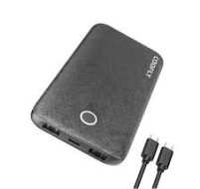
17
HARDWARE COMPONENTS
♦Raspberry Pi 4 Model B
It is the central processing unit
( Quad-core ARM Cortex-A72),
which Handles image processing,
AI model inference, and managing
communication between the
components.
♦Pi Camera Module v3
The camera module is essential
for capturing visual data, as
well as. It provides high-
quality image data that feeds
into models for processing.
♦Speaker
Wireless earbuds or wired
earphones that outputs audio
feedback to the user using
TTS engines.
♦Power supply (power bank)
Power bank with USB-C To make
the device truly portable and
wearable, it provides 5 volts at 3
amps, which is suitable for the
Raspberry Pi 4.

Slide 19
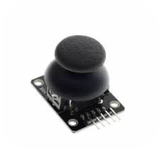
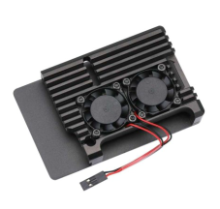
18
HARDWARE COMPONENTS
♦Joystick
Analog input device use to
select different modes. There
is two parts in joysticktwo
Potentiometers and Push
Button.
♦Aluminum Case with fan
Aluminium case (act like a heat
sink) with dual fans provide
efficient cooling that improve
thermal management also
Shields sensitive components
from physical damage and dust.
♦3D Printing glasses
Lightweight 3D-printed frame take shape of glasses,
Holds and aligns all hardware components.

Slide 20
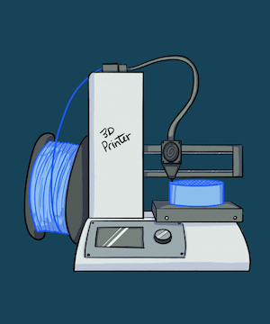
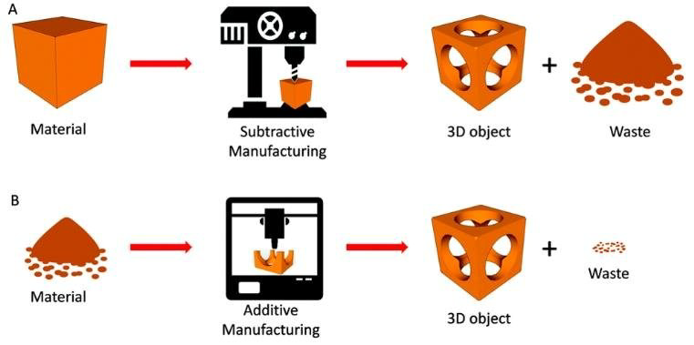
19
3D PRINTING
•3D printing falls under a section of digital fabrication that
creates physical objects from digital 3D models by adding
material layer by layer.
•It is also known as additive manufacturing because it
builds objects by adding material rather than subtracting
it like traditional manufacturing processes.

Slide 21
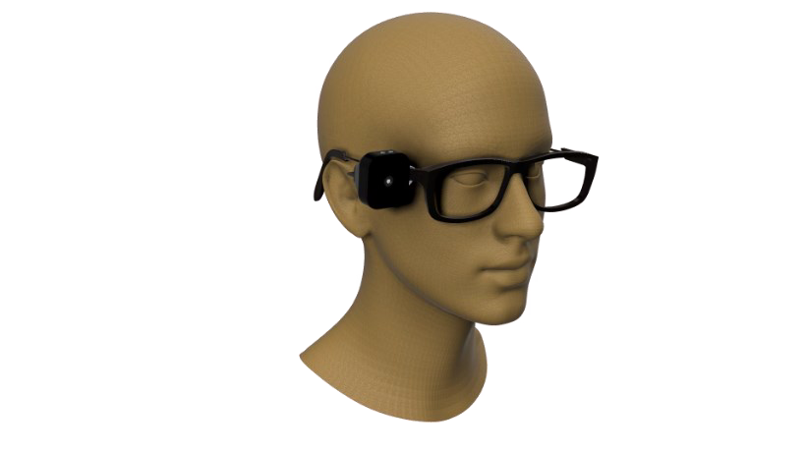
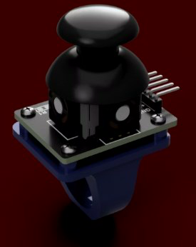
20
3D Model for Raspberry Pi
Camera & Glasses & Joystick

Slide 22







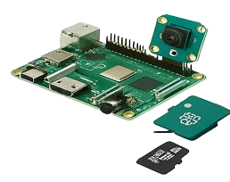
21
Hardware Setups & Preparation
Setup
Prepare Hardware
• Raspberry pi4
• Pi camera v3
• Micro SD card
• Power bank
Install OS
Use Raspberry Pi Imager
Configure
Raspberry Pi
• Setup the system
• Enable SSH
• Enable VNC
• Install updates
Preparation
Create a virtual
environment, install
libraries: TFLite, Picamera
After setup, system will be ready to use

Slide 23
System Architecture

Slide 24
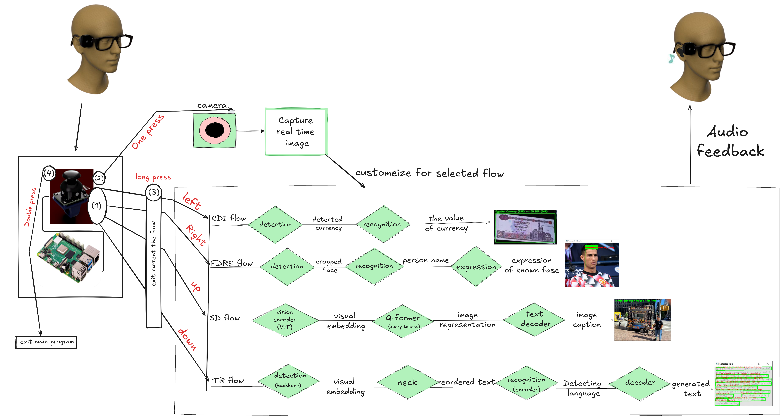

Slide 25









24
Technology And Tools

Slide 26
25
Click here
DEMO

Slide 27

26

